Slide 1


HOSPITAL MANAGMENT SYSTEM
Submitted By
Team Member: 01
Sanjida Khanom
0562310005101008
Spring:2023
Duration
2024 DEC-16th

Slide 2

Welcome
User Research
Welcome to the Presentation on Hospital Management System
Efficient Healthcare System for Modern Hospitals.

Slide 3

Hospital Management System
Project Overview:
The Hospital Management System is a comprehensive web-based application designed to streamline the operations and administration of a hospital. This system facilitates efficient management of essential functions, including patient registration, doctor management, appointment scheduling, income tracking, and reporting. It offers a centralized platform for hospital staff to ensure seamless communication and operational efficiency.

Slide 4
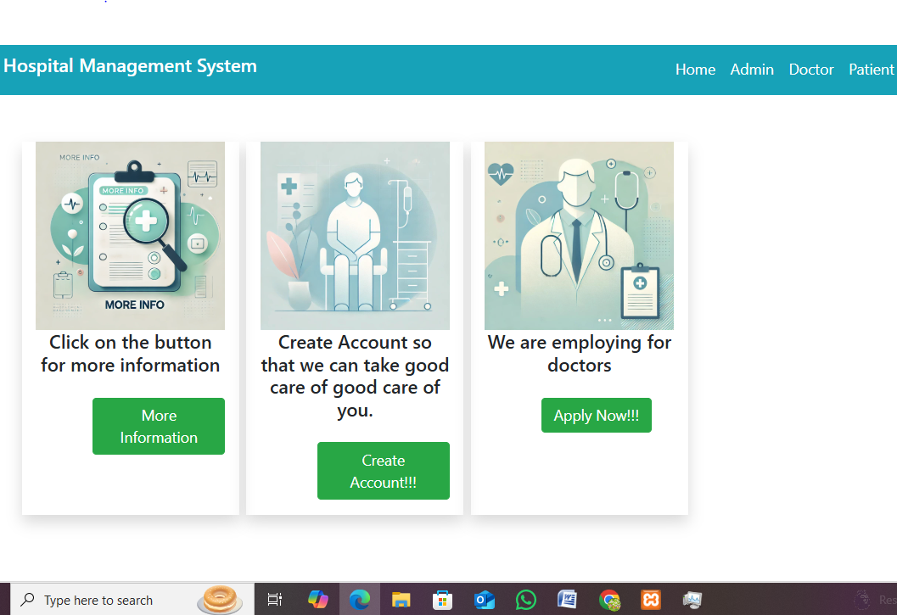


Slide 5

Overview
Motivation Behind the Project
1.Challenges in traditional hospital management:
2.Inefficient patient record handling.
3.Difficulty in appointment management
4.Limited access to income and report tracking.
Goal
A comprehensive system that integrates admin, doctor, and patient workflows.

Slide 6

Technologies Used
Frontend: HTML, CSS, Bootstrap
Backend: PHP(Core PHP Framework)
Database: MySQL

Slide 7
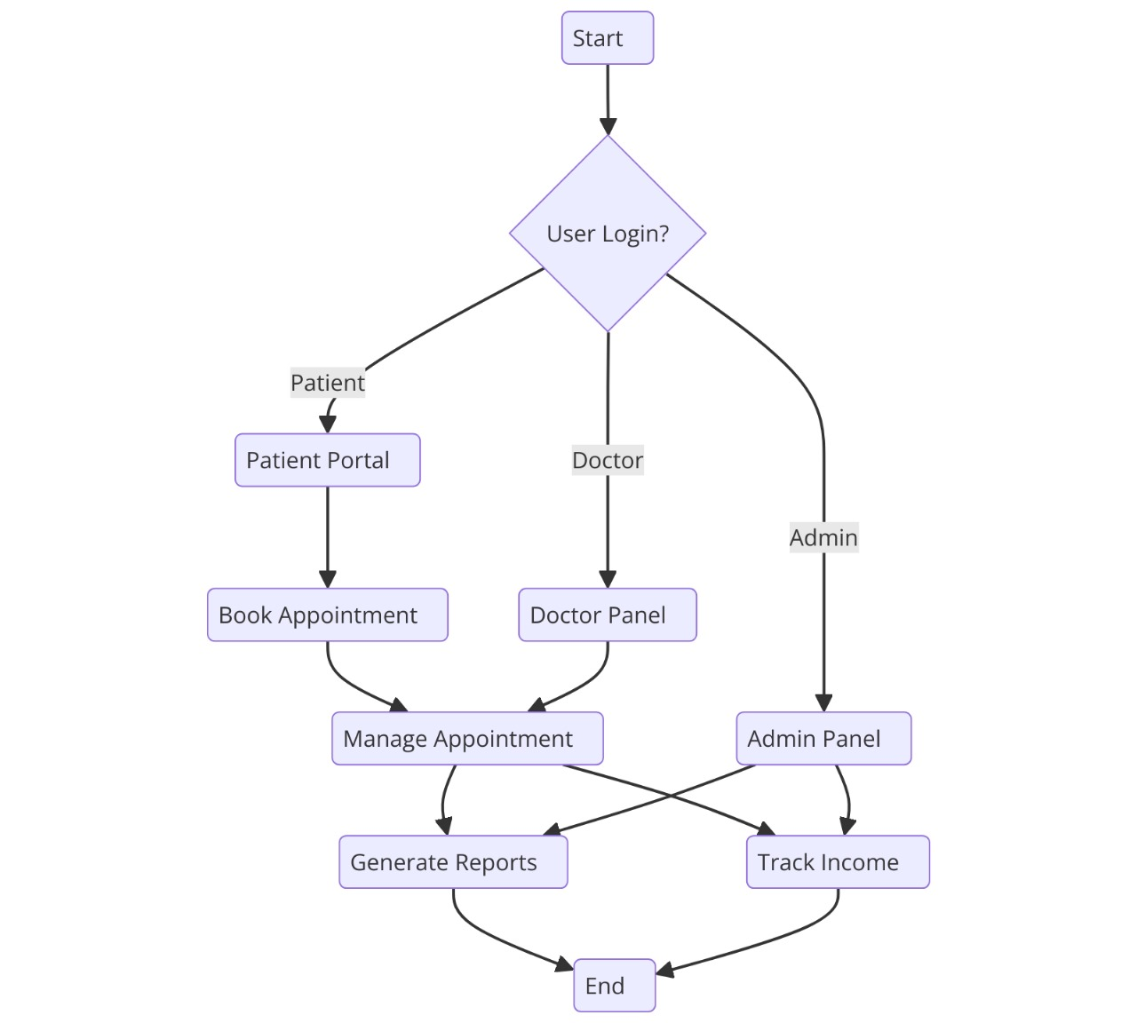

Slide 8
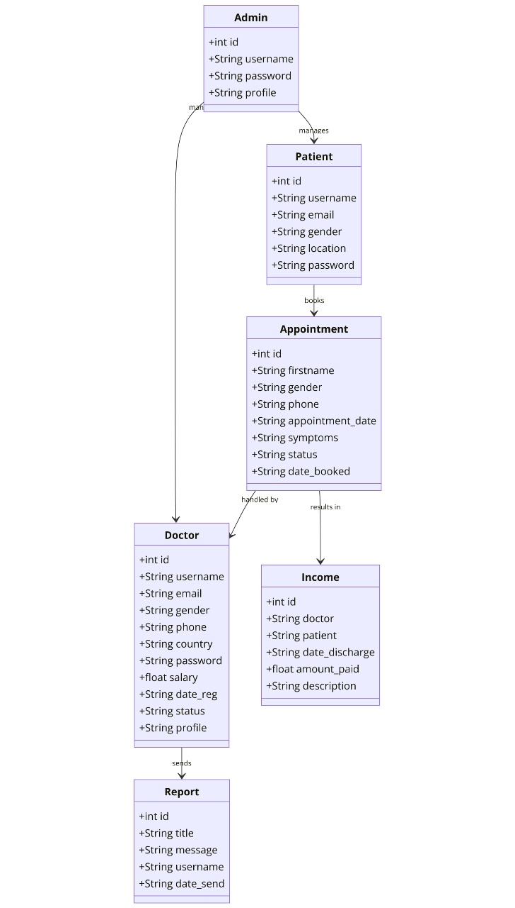

Slide 9

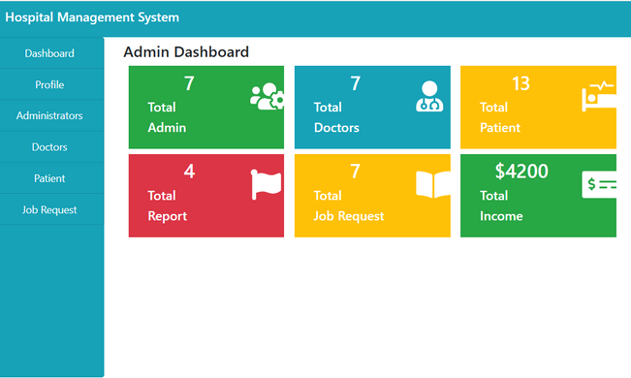
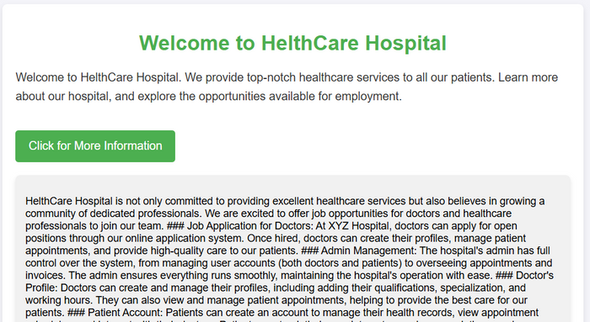
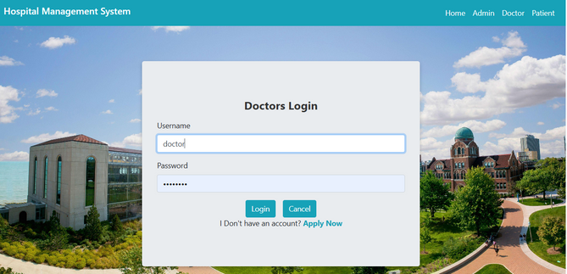
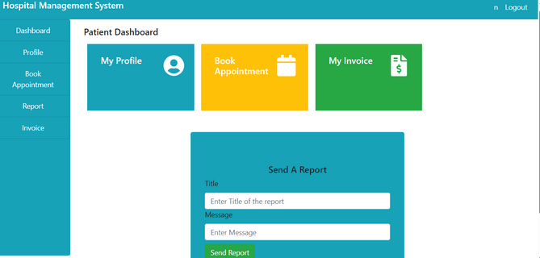
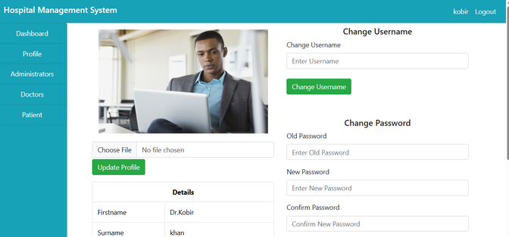
Key Features
User Research
Admin Panel: Secure login, manage users.
Doctor Management: Profile setup, salary records.
.
Appointment Scheduling: Easy booking, status tracking.
.
Income Tracking: Discharge records and payments.
Reports: Generate and manage feedback and queries

Slide 10


